Slide 1

VE475 Project1 Steganography and Cryptography
Li Shiqi, Gu Yucheng, shen shiyu, zhu shunyi

Slide 2
Content
A brief introduction to Cryptography and Steganography
Pros and Cons of the two approaches
An encryption algorithm combining both Cryptography and Steganography

Slide 3
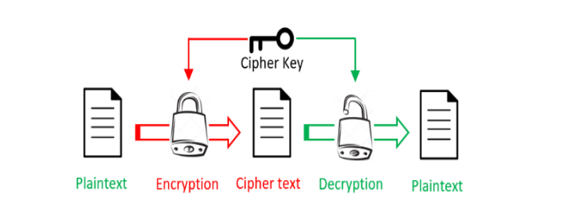
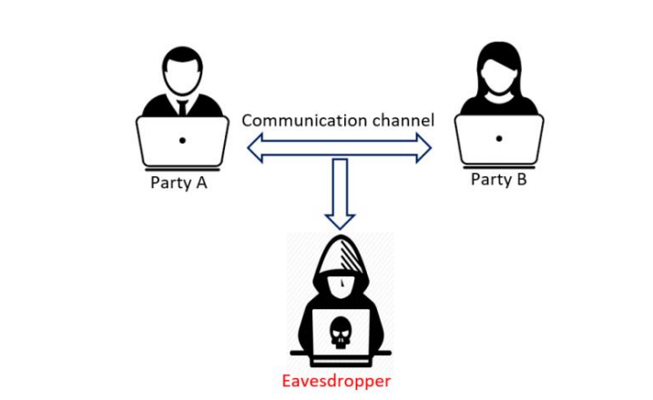
Cryptography
Goal: make the message unreadable to ensure data privacy

Slide 4
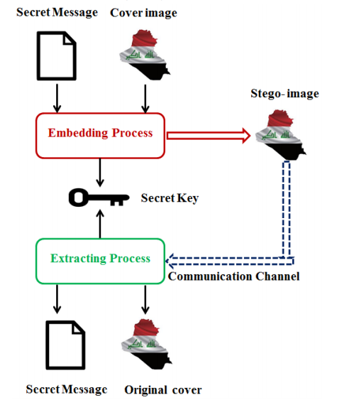
Steganography
However, sometimes an unreadable message is not secure.
Goal: Hide the message.
Methods:
Conceal secret message into cover message
Different medias are used to make the information hard to detect
Based on a secret key for embedding and extracting
Kerckhoffs’s principle still holds for steganography

Slide 5
“A cryptosystem should be secure even if everything about the system, except the key, is public knowledge.”
- Auguste Kerckhoffs

Slide 6
Cryptography vs. Steganography
Make the plaintext unreadable
Based on secret key for decryption (and encryption)
Cannot prevent an eavesdropper from getting the information
Make the communication process undetectable
Based on secret key for decryption (and encryption)
Prevent an eavesdropper from getting the information
Can be revealed by visual analysis and statistical analysis

Slide 7
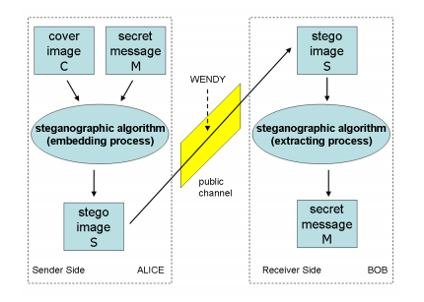
Steganography & Cryptography Algorithm
An encryption method combining steganography and cryptography through image processing.
Take prisoners’ problem as example:
Goal: communicate escape plan secretly.
Two main processes: Embedding Process and Extracting Process
ISC: Image-based Steganography and Cryptography

Slide 8
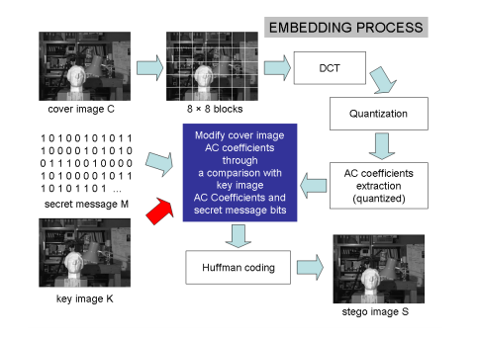
ISC Embedding Process
The embedding process will be a modification of
the JPEG encoding scheme.
An image C and a key image K
Divide image C and K into 8*8-pixel blocks
Apply Discrete Cosine Transform (DCT) and discard the DC coefficients and AC zero coefficients
Store the remaining AC coefficients into vector coverAC[] and keyAC[]
Perform embedding algorithm and modify coverAC[] to get stegoAC[]
Continue with stegoAC[] to perform Huffman coding to get a JPEG image

Slide 9
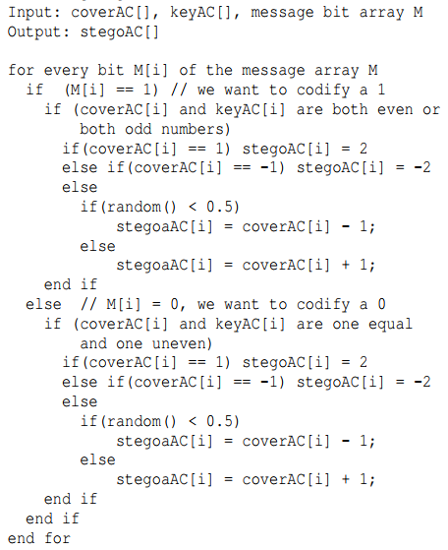
Embedding Algorithm
random() returns a random number in [0, 1)
We should avoid produce zero coefficients or we cannot extract them

Slide 10
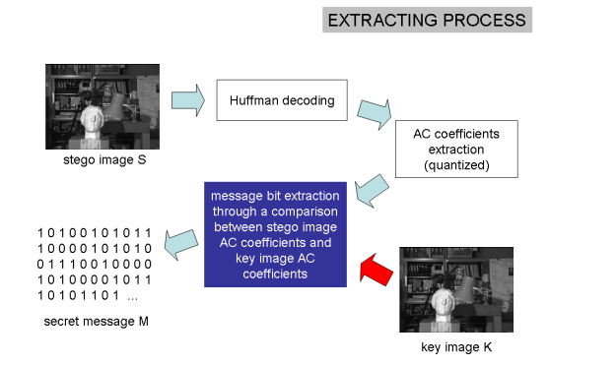
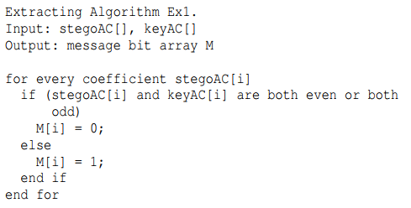
ISC Extracting Process
First decode the stego image S
Extract non-zero AC coefficients from S and K
Perform extracting algorithm to the extracted stegoAC[] and the key keyAC[]
Notes:
The ISC extracting process is very simple and consists in a comparison between S nonzero AC coefficients (stegoAC[]) and K nonzero AC coefficients (keyAC[]). In order to obtain these two sets of coefficients we perform a Huffman decoding step followed by the quantized AC coefficients extraction

Slide 11
Summary of ISC
ISC combines steganography and cryptography into an encryption method
Without the key image, the text cannot be revealed
Even Eve knows the whole process and gets both plain image C and stego image S, cannot break the system using simply XOR
Performance: According to experiment by Domenico Bloisi and Luca Iocchi, similar ISC can hide a message of size about 14% of the JPEG file dimension
The media is image or video, the communication process is secret

